Slide 1
DNA Structure

Slide 2
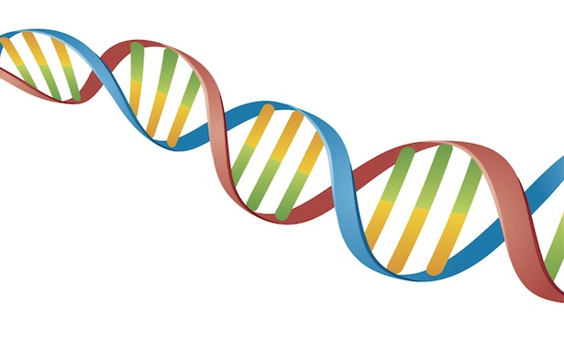
Warm Up- 2/6
What do you think is the purpose of DNA??

Slide 3
Warm Up- 2/7
What are the 3 things that make up a nucleotide?

Slide 4
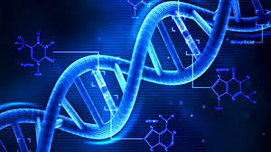
Notes: DNA Replication

Slide 5
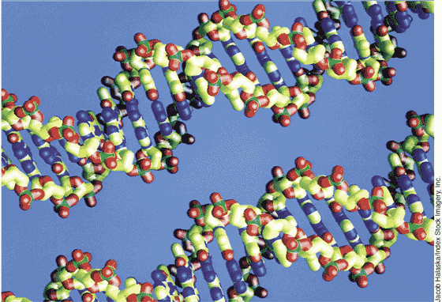
What is DNA?
DNA is one of the nucleic acid biomolecules which controls our genes.
DNA stands for Deoxyribonucleic Acid
DNA is the genetic material found inside the nucleus of eukaryotic cells.

Slide 6
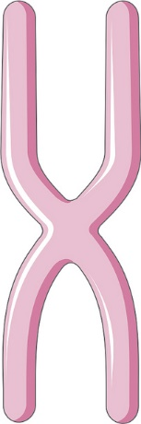
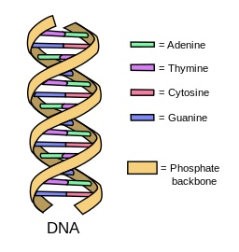
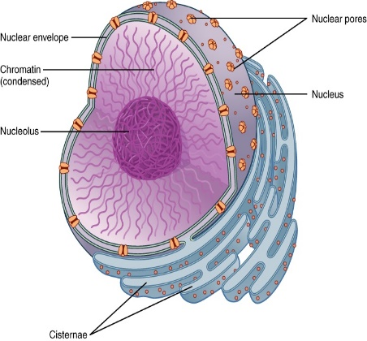
The Nucleus
In humans the nucleus contains chromosomes, there are 23 pairs of chromosomes, making 46 in total. Each paired chromosome has 2 variants of a gene. Genes are made of DNA. The genes code for our characteristics, such as eye color, hair type, they may even determine personality.
NUCLEUS
CHROMOSOME
DNA
BiologyGuy©

Slide 7
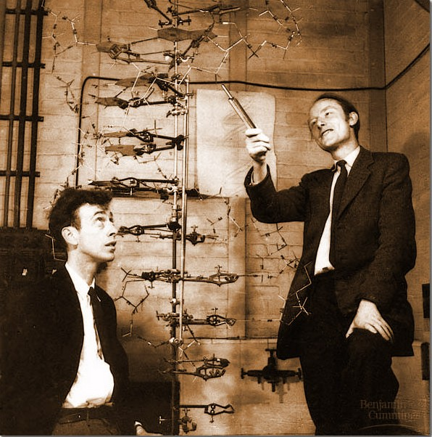
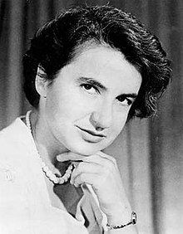
Discovering the Structure of DNA
Structure was discovered in 1953 by James Watson and Francis Crick
They were only able to complete the model after x rays taken of DNA through a microscope by a woman named Rosalind Franklin revealed the key to determining the true shape….she was never officially credited with the discovery ☹

Slide 8
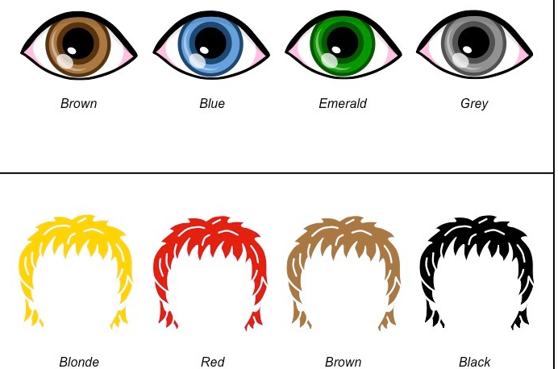
Purpose of DNA
Stores the genetic information
Instructs the cell on which proteins (biomolecule) to make.
Responsible for determining all organism’s traits such as eye color, body structure, and enzyme production.

Slide 9
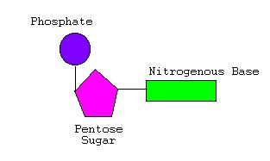
Parts of DNA
DNA is a long molecule made up of repeating units called nucleotides.
Nucleotides are made up of three parts:
  Sugar
  Phosphate Group
  Nitrogenous Base

Slide 10
Parts of DNA
DNA is constructed of 4 nucleotide bases:
  Adenine
  Thymine
  Cytosine
  Guanine
These bases are held together by a twisted sugar phosphate backbone.
The structure forms a double helix twisted ladder.
BiologyGuy©

Slide 11
Nucleotide Pairs
Each DNA base pairs with its complimentary base.
  Adenine (A) always pairs with Thymine (T)
  Guanine (G) always pairs with Cytosine (C)
A
T
G
C
T
A
C
G

Slide 12
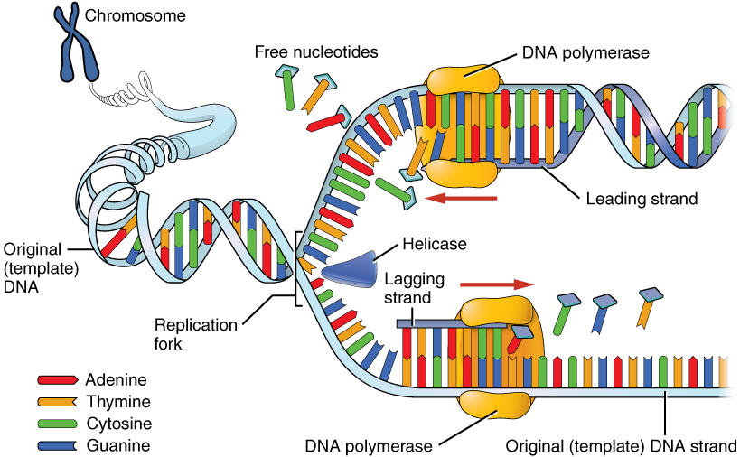
How does DNA get made?
BiologyGuy©

Slide 13
DNA Replication
DNA is replicated during the S-Phase of the cell cycle in the nucleus.
During this process the DNA needs to be copied and transferred to the new daughter cell.
DNA replication can be broken down into 3 steps.
Parent
DNA
DNA for daughter cells
BiologyGuy©

Slide 14
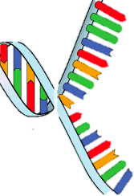
DNA Replication
In order for DNA to replicate itself it needs to make a copy of its DNA.
1st step: DNA Helicase unwinds the DNA strand. Splits into 5’ and 3’ ends.
As the DNA unwinds it exposes the base pairs:
- Adenine
- Thymine
- Cytosine
- Guanine
DNA unwinds or
unzips
DNA
BiologyGuy©

Slide 15
DNA Replication
Begins at Origins of Replication
Two strands open forming Replication Forks (Y-shaped region)
New strands grow at the forks
3’
Parental DNA Molecule
5’
Replication
Fork
3’
5’

Slide 16
DNA Replication
In the 2nd step the DNA that is unzipped then creates a complimentary DNA strands using the existing DNA as a template.
2nd Step: DNA polymerase builds new strand by adding complimentary nucleotide bases to the template strand.
Template STRAND
TEMPLATE:
3’ G A C T G A C T G A C 5’
Complimentary STRAND
BiologyGuy©

Slide 17
DNA Replication
DNA polymerase can only add nucleotides to the 3’ end of the DNA
This causes the NEW strand to be built in a 5’ to 3’ direction
5’
3’
5’
RNA
Primer
DNA Polymerase
Nucleotide

Slide 18
DNA Replication
In the 3rd step the DNA Polymerase has successfully created the new strands, that match the bases in the original strand.
3rd Step: DNA zips itself back up and now has a copy of its DNA.
Original Template strand
TEMPLATE STRAND
5’ G A C T G A C T G A C 3’
3’ C T G A C T G A C T G 5’
DNA zips up
This DNA is identical to the original parent DNA.
New strand
BiologyGuy©

Slide 19
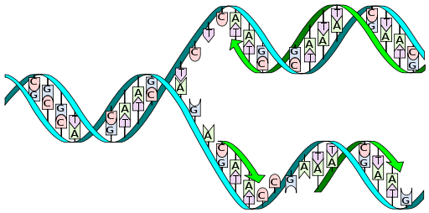
Summary of How DNA is replicated for growth:
Step 1. The DNA is unzipped
Step 2: DNA polymerase is used to create a complimentary strand to the original strand.
Step 3: The complementary strand and original strand zip together, forming DNA that is identical to the parent DNA
Parent DNA
1
2
The daughter DNA contains one new strand (complementary strand) and one old strand which came from the parent
Daughter DNA
3
BiologyGuy©

Slide 20
Summary of How DNA is replicated for growth:
PARENT CELL
Once the cell has a copy of the DNA it is ready to divide and produce a new daughter cell. This is called MITOSIS.
DAUGHTER CELLS
BiologyGuy©

